Slide 1
Hot Hand Phenomenon
Ariel Abramowitz
Gil Weissman

Slide 2
TABLE OF CONTENTS
01
02
03
04
Introduction
Phenomenon definition and related work
Data & Statitics
The dataset that was used and first insights regarding it
Assumptions & Methods
Casual inference assumptions, methods and algorithms
Results & Discussion
Experiments’ results, sensitivity analysis and discussion

Slide 3
Introduction
01

Slide 4
Definition
The "hot hand" is a phenomenon, that a person who experiences a successful outcome has a greater chance of success in further attempts. The concept is often applied to sports and skill-based tasks in general and originates from basketball, where a shooter is more likely to score if their previous attempts were successful.

Slide 5
Previous Work
Gilovich, Vallone, and Tversky^{[1]} , in which the authors found that that the “hot hand” momentum does not exist, despite the belief among basketball fans and experts that there is momentum in shooting performance.
In the years since the seminal paper was published, a consensus has emerged that the hot hand is a “myth”^{[2][3]}
Some recent studies^{[4]} have observed evidence for the "hot hand" in some sporting activities, and found that some previous didn't observed it due to biased selection. However, other recent studies^{[5][6]} have not observed evidence of the "hot hand".

Slide 6
Null Hypothesis
Given the previous work, our null hypothesis is that the hot hand effect does not exist in the NBA league. In other words, we believe that there is no causality relation between success of previous shot to the success of the next shot of the same player at the same game.

Slide 7
Data & Statistics
02

Slide 8

DATASET
Confounders:
Location
Shot number
Period
Game clock
Shot clock
Dribbles
Touch time
Shot distance
Back to back
Closest defender distance
Player weight
Player height
Defender weight
Defender height
Previous 3P%
Previous FT%
Previous FG%
Dataset Statistics:
102,692 ($→$59,552) shots
219 different players
1808 games
X, Y and Treatment:
X – Shot (with all its data)
Y - FGM
Treatment – Previous FGM

Slide 9
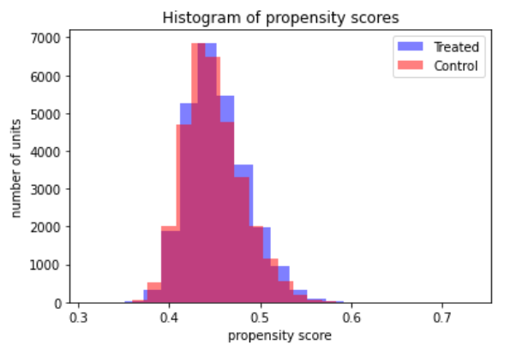

Slide 10
03
Assumptions & Methods

Slide 11
Assumptions
SUTVA
CONSISTENCY
IGNORABILITY
COMMON SUPPORT

Slide 12

IPW
In this method each unit is weighted using the inverse of its propensity score estimation.
Propensity score of unit $i$ is defined as $P(t_{i}=1|x_{i})$
The estimation of ATE is:
$$\hat{ATE}={(\sum_{i=1}^{n}{\frac{t_{i}}{\hat{e_{i}}}})}^{−1}\sum_{i=1}^{n}{\frac{y_{i}t_{i}}{\hat{e_{i}}}}−{(\sum_{i=1}^{n}{\frac{1−t_{i}}{1−\hat{e_{i}}}})}^{−1}\sum_{i=1}^{n}{\frac{y_{i}(1−t_{i})}{1−\hat{e_{i}}}}$$
where $\hat{e_{i}}=\hat{P}(t_{i}=1|x_{i})$ is the propensity score, estimated using logistic regression.

Slide 13

S-Learner
In this method, we use gradient boosting, i.e., a model $f(X,T)$ for estimating $Y$.
The estimation of ATE is:
$$\hat{ATE}=\frac{1}{n}\sum_{i=1}^{n}{f\left(x_{i},1\right)−f\left(x_{i},0\right)}$$
$f\left(X,T\right)$ was trained with $X$ and $T$ as the training set and $Y$ as the test set.

Slide 14

T-Learner
In this method, we use gradient boosting, i.e., two estimators, $f_{1}(X)$ for the treatment group and $f_{0}(X)$for the control group.
The estimation of ATE is:
$$\hat{ATE}=\frac{1}{n}\sum_{i=1}^{n}{f_{1}\left(x_{i}\right)−f_{0}\left(x_{i}\right)}$$
$f_{1}\left(X\right)$ was trained with $X$ of the treatment group as the training set and $Y$ of the treatment group as the test set.
$f_{0}\left(X\right)$ was trained with $X$ of the control group as the training set and $Y$ of the control group as the test set.

Slide 15

Matching
In this method, we use 1-Nearsest-Neighbor model to estimate the potential outcome of the "opposite" treatment using the most similar unit from the "opposite" group. The metric that we used is Euclidean distance on full covariates.
The estimation of ATE is:
$$\hat{ATE}=\frac{1}{n}\sum_{i=1}^{n}{ITE\left(i\right)}$$
where:
$$ITE\left(i\right)=\left\{\begin{aligned}y_{i}−y_{\arg{\min_{\begin{aligned}j s.t. \\ t_{i}≠t_{j}\end{aligned}}{d\left(x_{i},x_{j}\right)}}}, t=1 \\ y_{\arg{\min_{\begin{aligned}j s.t \\ t_{i}≠t_{j}\end{aligned}}{d\left(x_{i},x_{j}\right)}}}−y_{i}, t_{i}=0\end{aligned}\right.$$

Slide 16
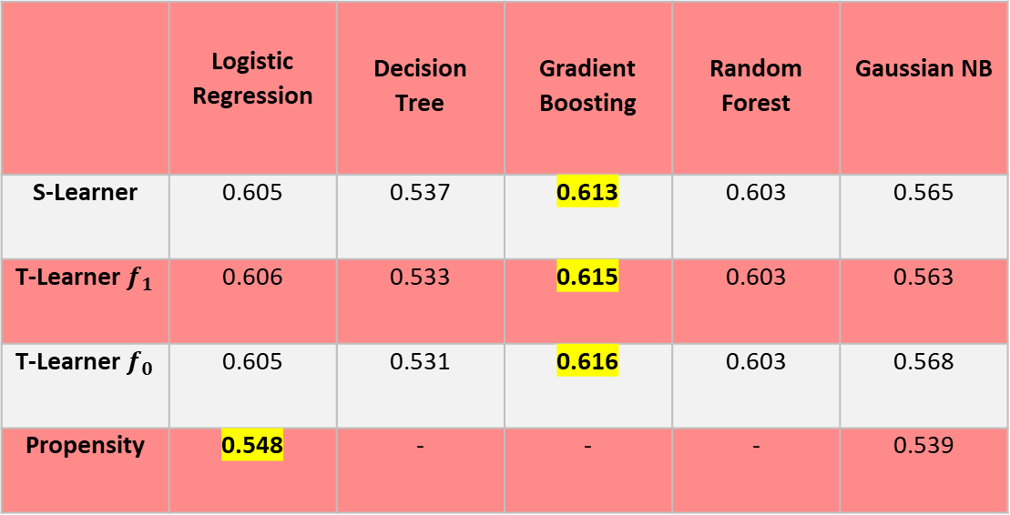
Model Selection
 | Logistic Regression | Decision Tree | Gradient Boosting | Random Forest | Gaussian NB
S-Learner | 0.605 | 0.537 | 0.613 | 0.603 | 0.565
T-Learner $f_{1}$ | 0.606 | 0.533 | 0.615 | 0.603 | 0.563
T-Learner $f_{0}$ | 0.605 | 0.531 | 0.616 | 0.603 | 0.568
Propensity | 0.548 | - | - | - | 0.539
Cross Validation accuracy per model, task

Slide 17
04
Results & Discussion

Slide 18
ATE VALUES
IPW | S-Learner | T-Learner | Matching
0.001 | 0 | -0.022 | -0.026
[-0.01, 0.008] | [-0.002, 0.001] | [-0.039, 0.007] | [-0.042, -0.005]
All data
Bootstrap sampling

Slide 19
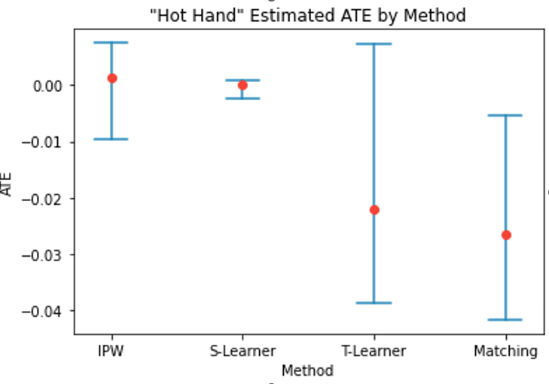

Slide 20

SENSITIVITY ANALYSIS
For method ATE estimation, we estimated the "tipping point".
IPW | S-Learner | T-Learner | Matching
0.001 | 0 | -0.022 | -0.026
-0.003 | 0 | 0.046 | 0.055
ATE value
Tipping point
The estimation of the tipping point is:
$$λ^{∗}=λ s.t. ATE+\left(Bias_{1}+Bias_{0}\right)=0$$

Slide 21
DISCUSSION
In 3 out of 4 methods, the confidence intervals include 0.
No significant evidence of a "hot hand" effect was found in the data tested.
We do not reject the null hypothesis and conclude that "hot hand" does not exist in the NBA league.

Slide 22
THANKS

Slide 23
Bibliography
https://en.wikipedia.org/wiki/Hot_hand
^{[1]} Gilovich, Thomas, Robert Vallone, and Amos Tversky. "The hot hand in basketball: On the misperception of random sequences." Cognitive psychology 17.3 (1985): 295-314.‏
^{[2]} Kahneman, D. (2011): Thinking, Fast and Slow, Farrar, Straus and Giroux.
^{[3]} Thaler, R. H. and C. R. Sunstein (2008): Nudge: Improving Decisions About Health, Wealth, and Happiness, Yale University Press.
^{[4]} Miller, Joshua B., and Adam Sanjurjo. "Surprised by the hot hand fallacy? A truth in the law of small numbers." Econometrica 86.6 (2018): 2019-2047.‏
^{[5]} McNair, Brian, et al. "The Hot Hand and Its Effect on the NBA." arXiv preprint arXiv:2010.15943 (2020).
^{[6]} Avugos, S., Köppen, J., Czienskowski, U., Raab, M., & Bar-Eli, M. The “hot hand” reconsidered: A meta- analytic approach. Psychology of Sport and Exercise, 14(1), 21-27.

